Slide 1
Personalized Ecommerce Recommendation
Reya Sadhu
Atharvraj Patil
Arnav Kulkarni
Allen Chen
Date: 4th December 2024

Slide 2



Presentation Overview
Dataset’s features and key statistics, descriptive summaries, and insights into data distribution.
Data Overview & Statistics
Temporal trends such as daily, weekly, and monthly seasonality to identify patterns in user behavior.
Seasonal Trends & Patterns
Site visiting patterns, view to purchase ratio, engagement frequency, abnormal traffic analysis.
User and Item Level Analytics
Data Manipulation, modelling techniques, evaluation metrics and insights from prediction.
Modelling & Results

Slide 3



General Ecommerce Analytics Data Structure
User-Item Interaction
Derived Attributes
Historical interactions features, like number of visits, views, average ratings, time spent, frequency of interaction.
Type of interactions user is having with an item: impressions, clicks, views, rating, review, purchases, along with their timestamp.
User Attributes
Item Attributes
User demographics, age, gender, location, behavioral pattern, search history.
Item price, tags, title, description, quantity, category, rating, availability, visual features, material etc.

Slide 4



Ecommerce Sales Funnel
1. Visits Store
2. Views Items
3. Adds to cart
4. Initiates Checkout
5. Completes Transaction

Slide 5





Ecommerce Sales Funnel
1. Visits Store
2. Views Items
3. Adds to cart
4. Initiates Checkout
5. Completes Transaction

Slide 6


RetailRocket Ecommerce Data Description
1.4M
400K
2.7M
1180
Users
Items
Interactions
Categories
Three types of interactions
Timeline
Item Properties
1
View (click)
Add-to-cart
Transaction
2
2015-05-02
To
2015-09-17
3
Except availability and category, all other properties are hashed
Events
Item properties
Category tree
User
Item
Event
Time
Item
Time
Properties
Category
Parent category
Notes:
Generally, in ecommerce view means impressions, that means every time a product is displayed on a page to a user, even if they don't click on it
Here View means user has clicked on the item, as given in the data description

Slide 7

Data Insights
How does the seasonal trend look? Can we explain those? Can we focus our marketing or promotional strategy to fit them?
Trend
What are the dropout rates between each step to understand potential friction points in the buying process?
Bottlenecks
Which are the loyal customers? How often do they purchase in a specified timeframe? Which segment can be potential churners?
Customer Segmentation
Venus
Which are the top selling items? What categories do they belong to? Which products are viewed but not purchased?
Item Segregation
Abnormality
Are there any unusual traffic? How do we detect them? Can they affect the recommendations?

Slide 8
Data Insights
How does the seasonal trend look? Can we explain those? Can we focus our marketing or promotional strategy to fit them?
Trend
What are the dropout rates between each step to understand potential friction points in the buying process?
Bottlenecks
Which are the loyal customers? How often do they purchase in a specified timeframe? Which segment can be potential churners?
Customer Segmentation
Venus
Which are the top selling items? What categories do they belong to? Which products are viewed but not purchased?
Item Segregation
Abnormality
Are there any unusual traffic? How do we detect them? Can they affect the recommendations?

Slide 9
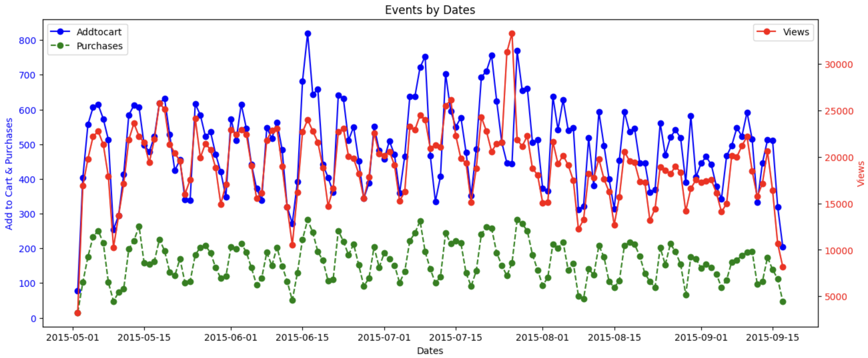
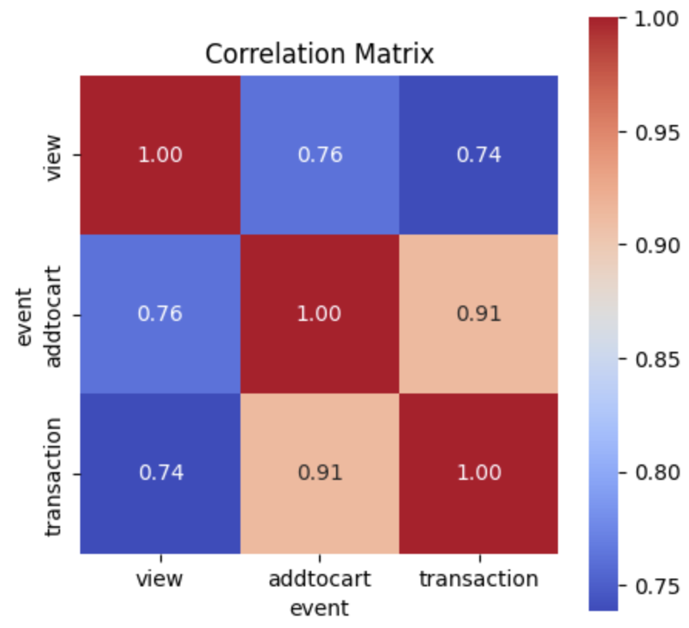
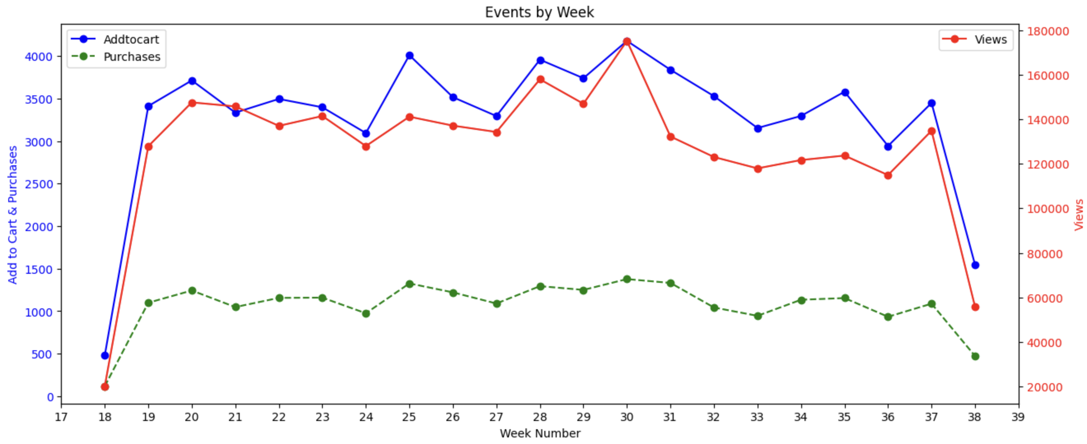
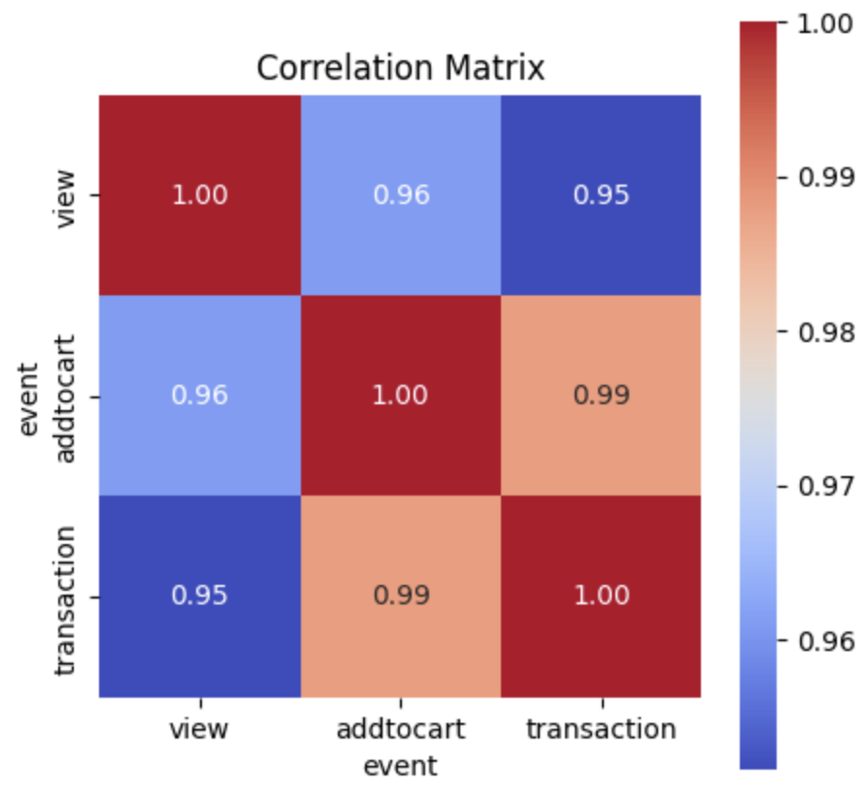
On daily level, there are fluctuations caused by random events such as holidays, promotions, weather etc.
Regular Weekly Cycles
The overall trend looks more apparent. We have strong correlations.

Slide 10
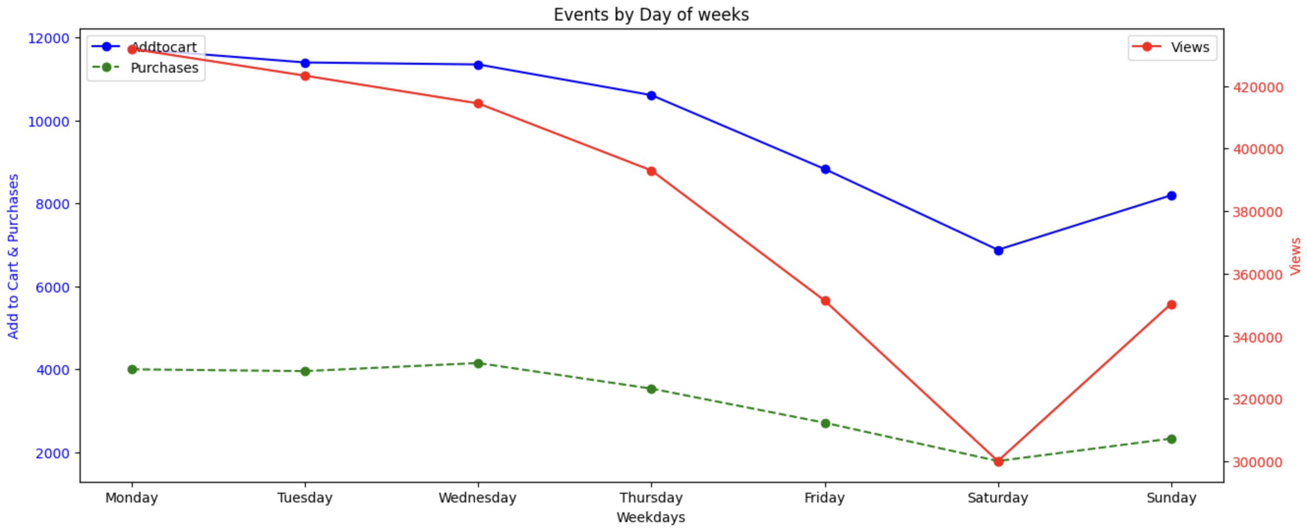
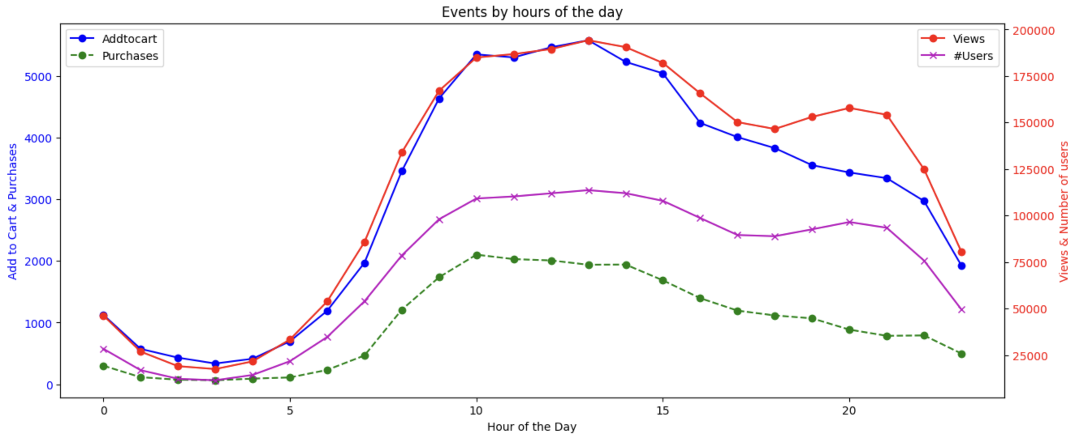
Explains the weekly cycles!
This is a normal phenomena in e-commerce: lower engagement and sales on weekends!
Many e-commerce businesses focus their marketing efforts on weekdays, often launching promotions and advertisements that pique interest during work hours.
Most activities happen between 8 am to 8 pm.
Not only the number of users increase during this peak period, activities per user also increase.
# Users almost same as #Views

Slide 11
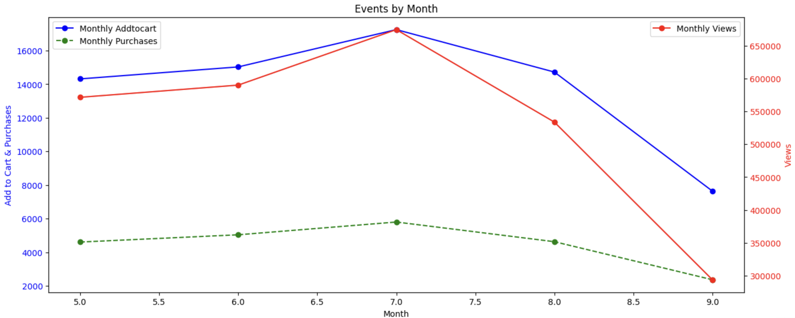
July shows the highest engagement and sales.
Mostly due to back-to-school sales

Slide 12
Data Insights
How does the seasonal trend look? Can we explain those? Can we focus our marketing or promotional strategy to fit them?
Trend
What are the dropout rates between each step to understand potential friction points in the buying process?
Bottlenecks
Which are the loyal customers? How often do they purchase in a specified timeframe? Which segment can be potential churners?
Customer Segmentation
Venus
Which are the top selling items? What categories do they belong to? Which products are viewed but not purchased?
Item Segregation
Abnormality
Are there any unusual traffic? How do we detect them? Can they affect the recommendations?

Slide 13
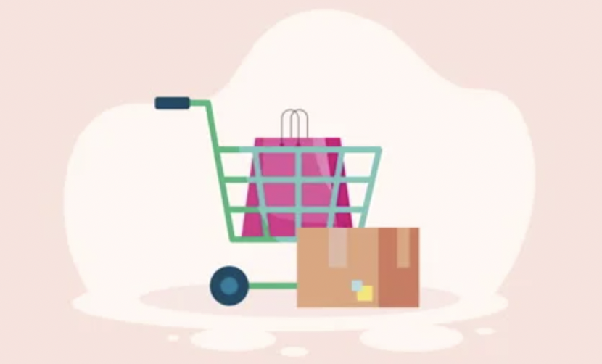
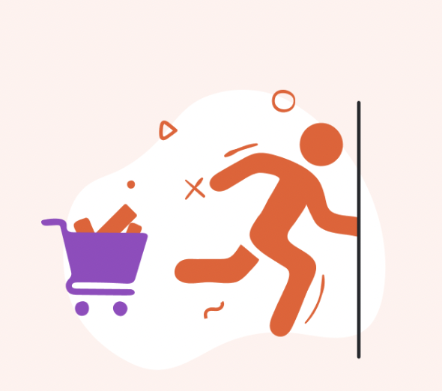
VIEWS
ADD TO CART
PURCHASES
2.5%
32.5%
Add-to-Cart rate: 2.5%
Cart abandonment Rate: 68%
Average: 7-8%
Average: 70%

Slide 14
Data Insights
How does the seasonal trend look? Can we explain those? Can we focus our marketing or promotional strategy to fit them?
Trend
What are the dropout rates between each step to understand potential friction points in the buying process?
Bottlenecks
Which are the loyal customers? How often do they purchase in a specified timeframe? Which segment can be potential churners?
Customer Segmentation
Venus
Which are the top selling items? What categories do they belong to? Which products are viewed but not purchased?
Item Segregation
Abnormality
Are there any unusual traffic? How do we detect them? Can they affect the recommendations?
Notes:
We might want to cluster our customers, to find who are the loyal customers? Who can be a potential customer?

Slide 15
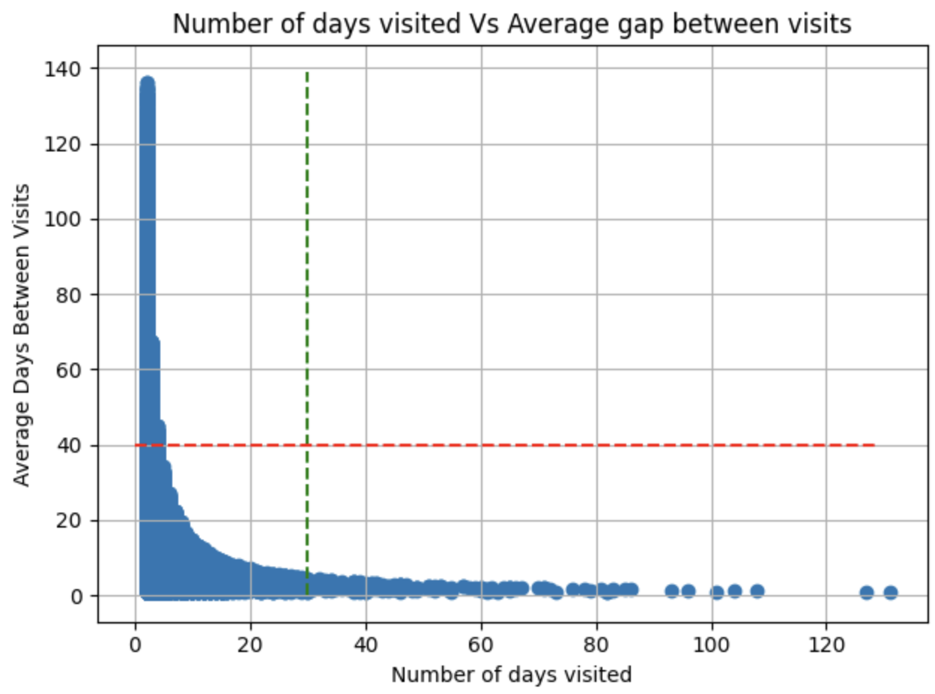
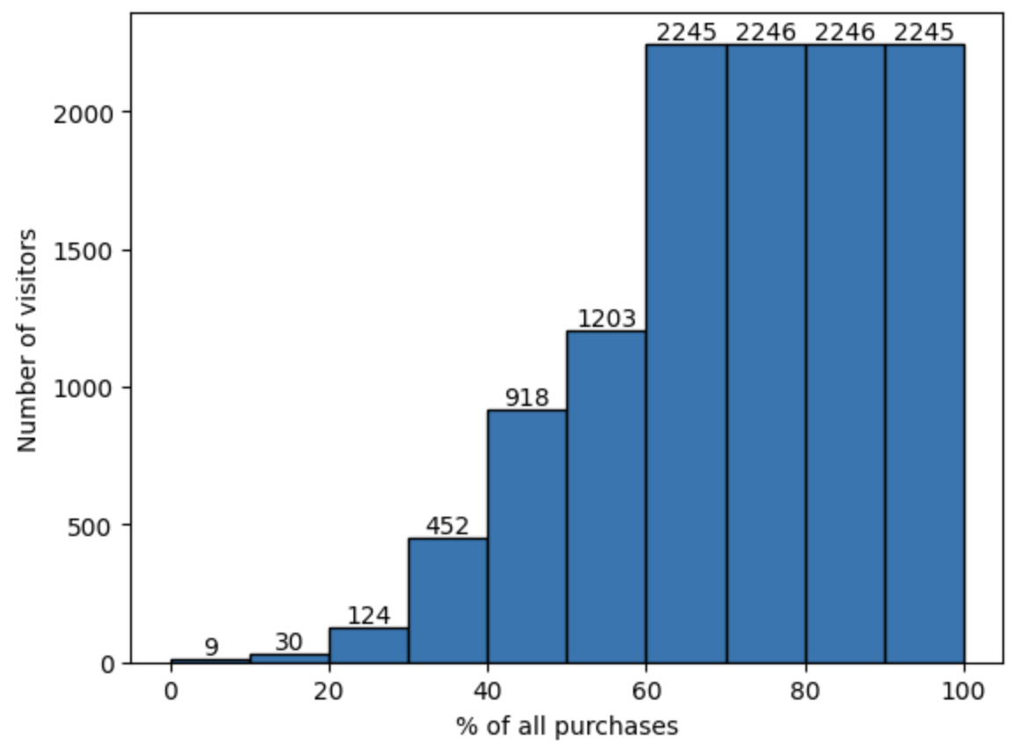
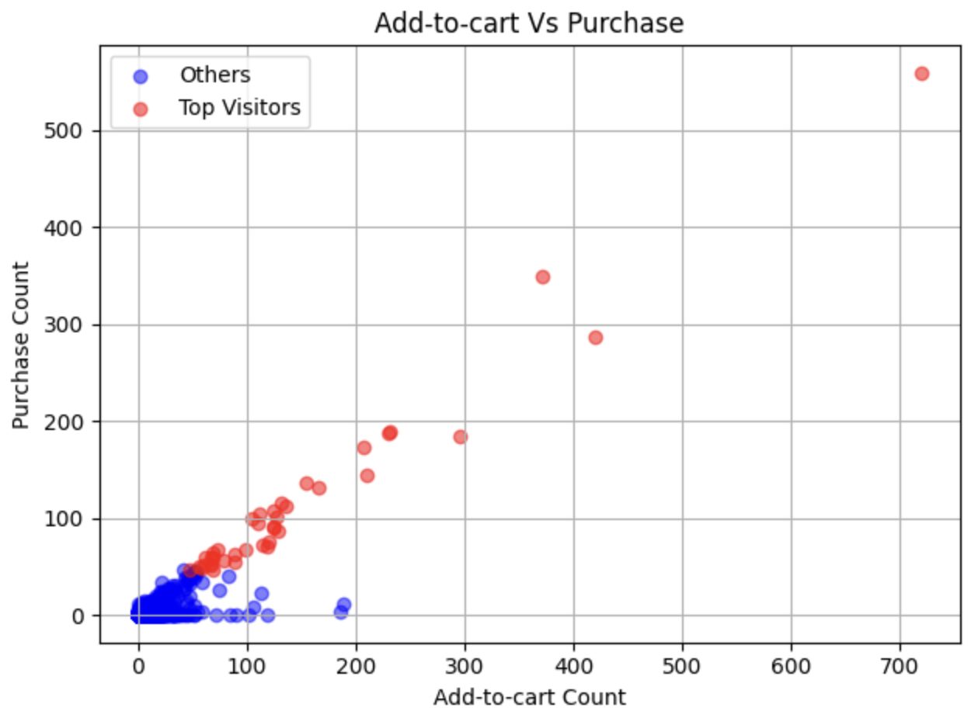
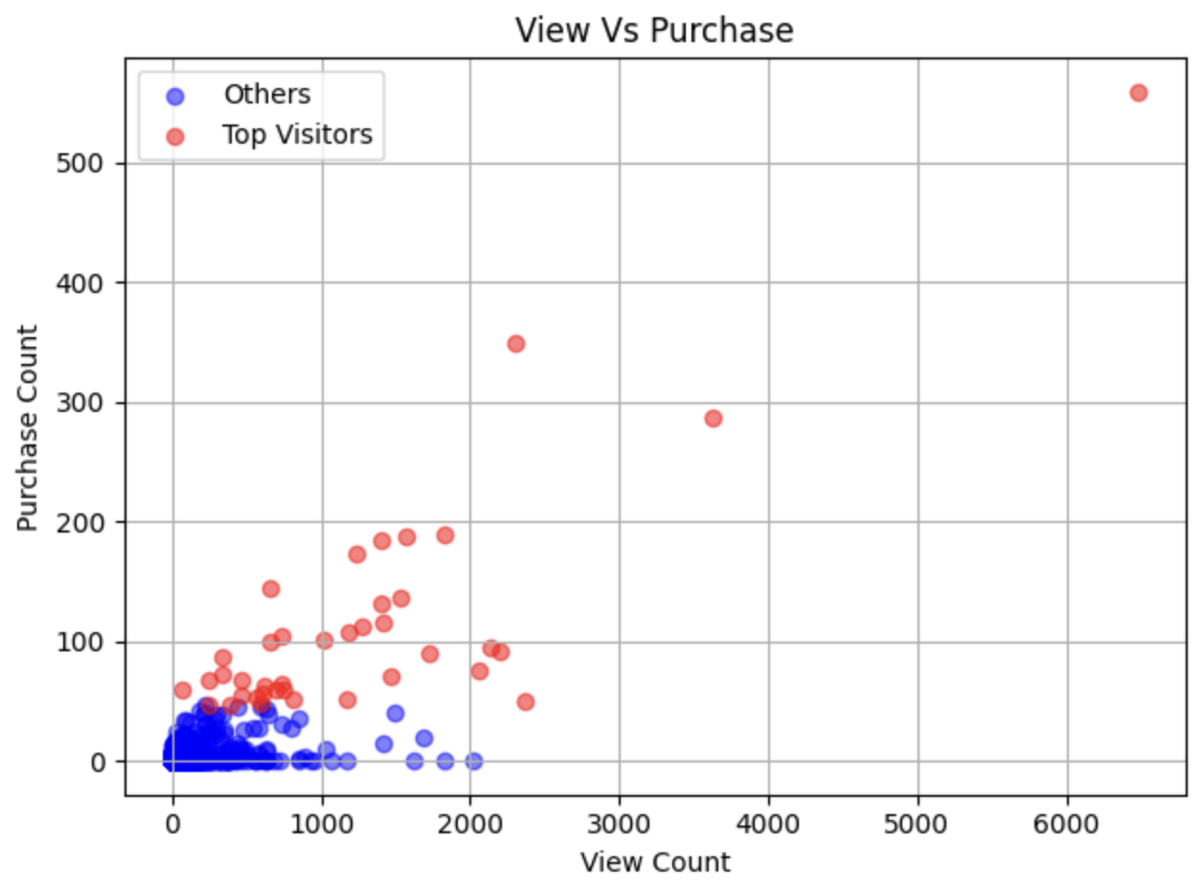
Lack of Engagement
Top Customers
Loyal visitors
Only 39 users among 1.4M users are responsible for 20% of total sales!
Better recommendations
Repeating customers but not buying!
Cart abandonment
Notes:
First we want to see their activity, like how many days they have visited the website. How frequent are those visits? So for each visitor, we plot the average days between two visits vs number of days visited.
The bottom right quandrant shows the loyal frequqnt visitors, they have visited a lot with very little gap between visits.
However, the top left section has visited very less time and also with a l,arge gap. So, they are landing on our website but not visiting again, we might want to find why is there a lack of engagememt.

Slide 16
Lack of Engagement
Top Customers
Loyal visitors
Only 39 users among 1.4M users are responsible for 20% of total sales!
Better recommendations
Repeating customers but not buying!
Cart abandonment
Notes:
If we move opur focus to the paying customers, not just visitors, from the histogram of these purchases, we can see only a few users like 13k has actually made a purchase.
Also, only 39 people are responsible for 20% of total sales. We are not talking about monetary sales, it’s the number of items sold.

Slide 17
Lack of Engagement
Top Customers
Loyal visitors
Only 39 users among 1.4M users are responsible for 20% of total sales!
Better recommendations
Repeating customers but not buying!
Cart abandonment
Notes:
Now we want to identify these customers who are viewing but not purchasing anything, we can see this view vs purchase plot.
On this green box, we can see people not viewing or purchasing at all, so not interacting at all. In our case view means clicking, so there should be better recommendation for them to click on an item.

Slide 18
Data Insights
How does the seasonal trend look? Can we explain those? Can we focus our marketing or promotional strategy to fit them?
Trend
What are the dropout rates between each step to understand potential friction points in the buying process?
Bottlenecks
Which are the loyal customers? How often do they purchase in a specified timeframe? Which segment can be potential churners?
Customer Segmentation
Venus
Which are the top selling items? What categories do they belong to? Which products are viewed but not purchased?
Item Segregation
Abnormality
Are there any unusual traffic? How do we detect them? Can they affect the recommendations?

Slide 19
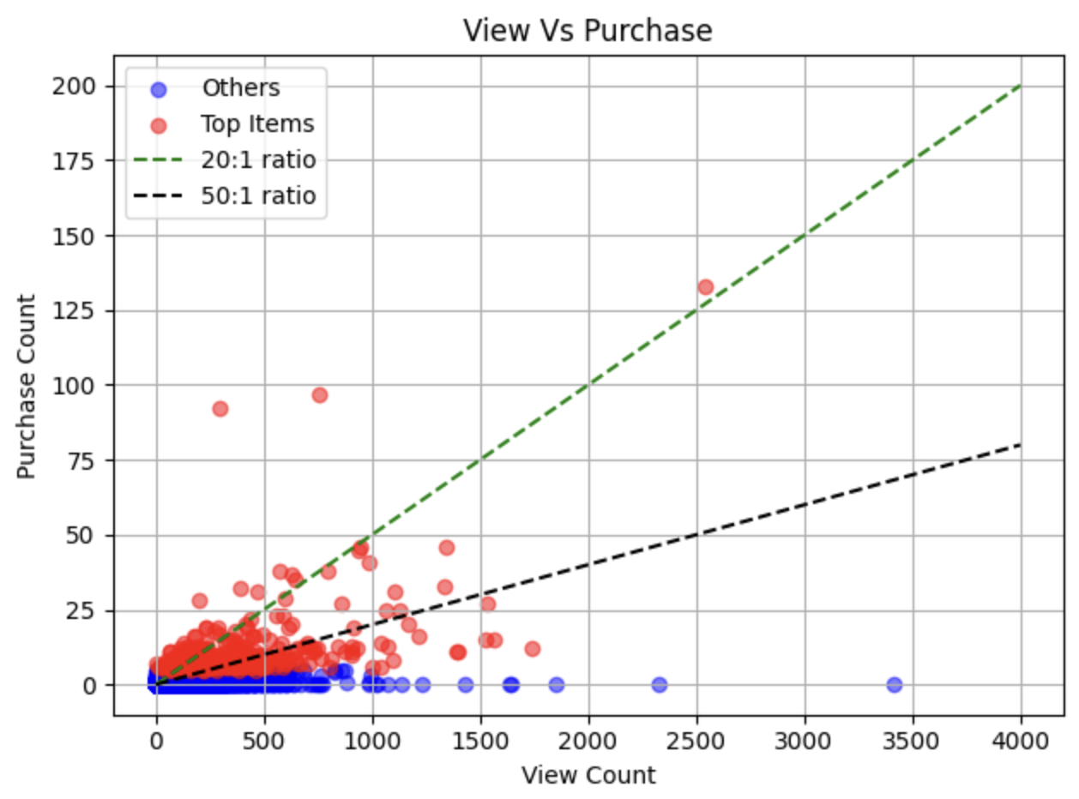
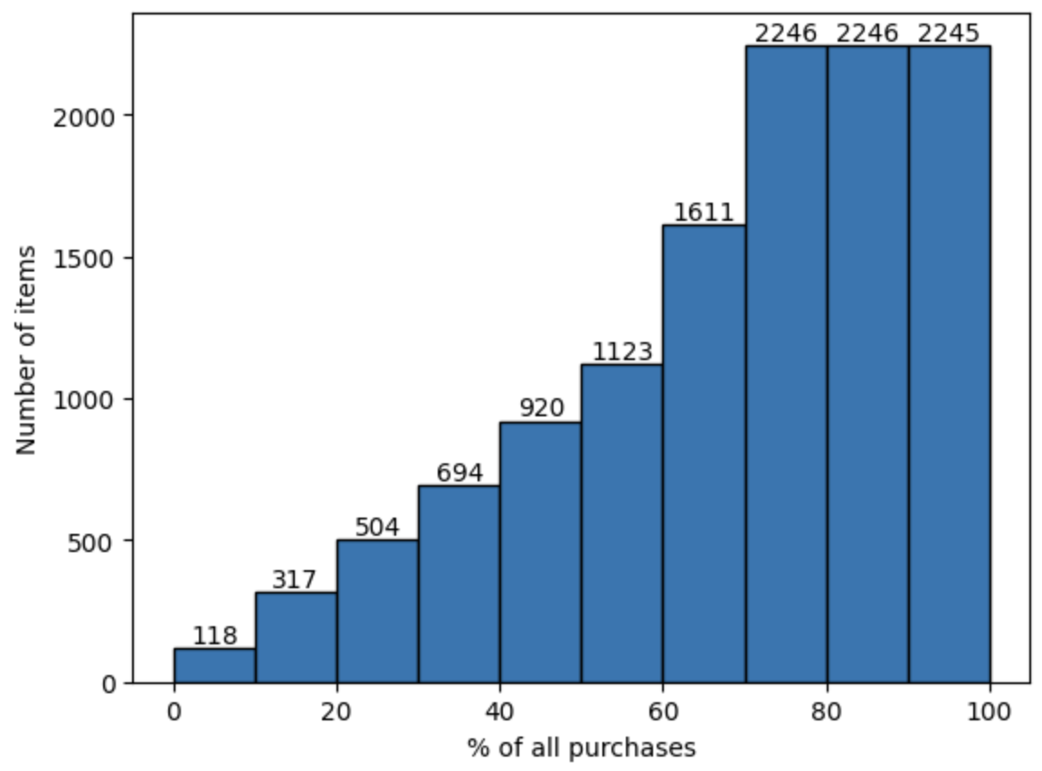
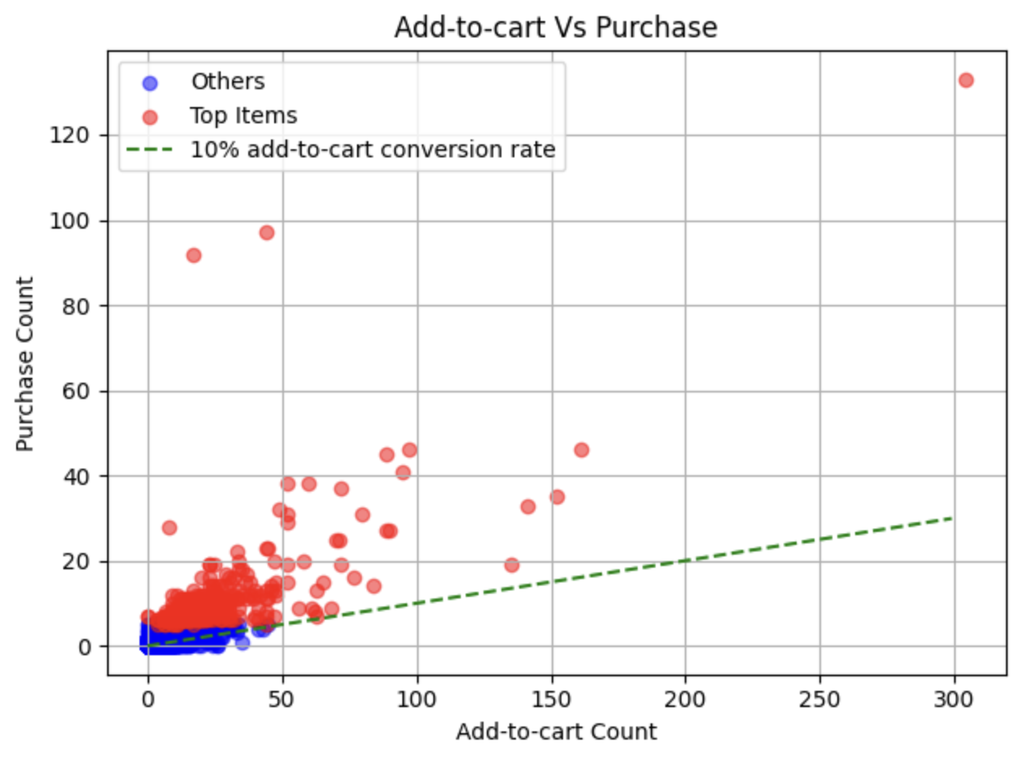
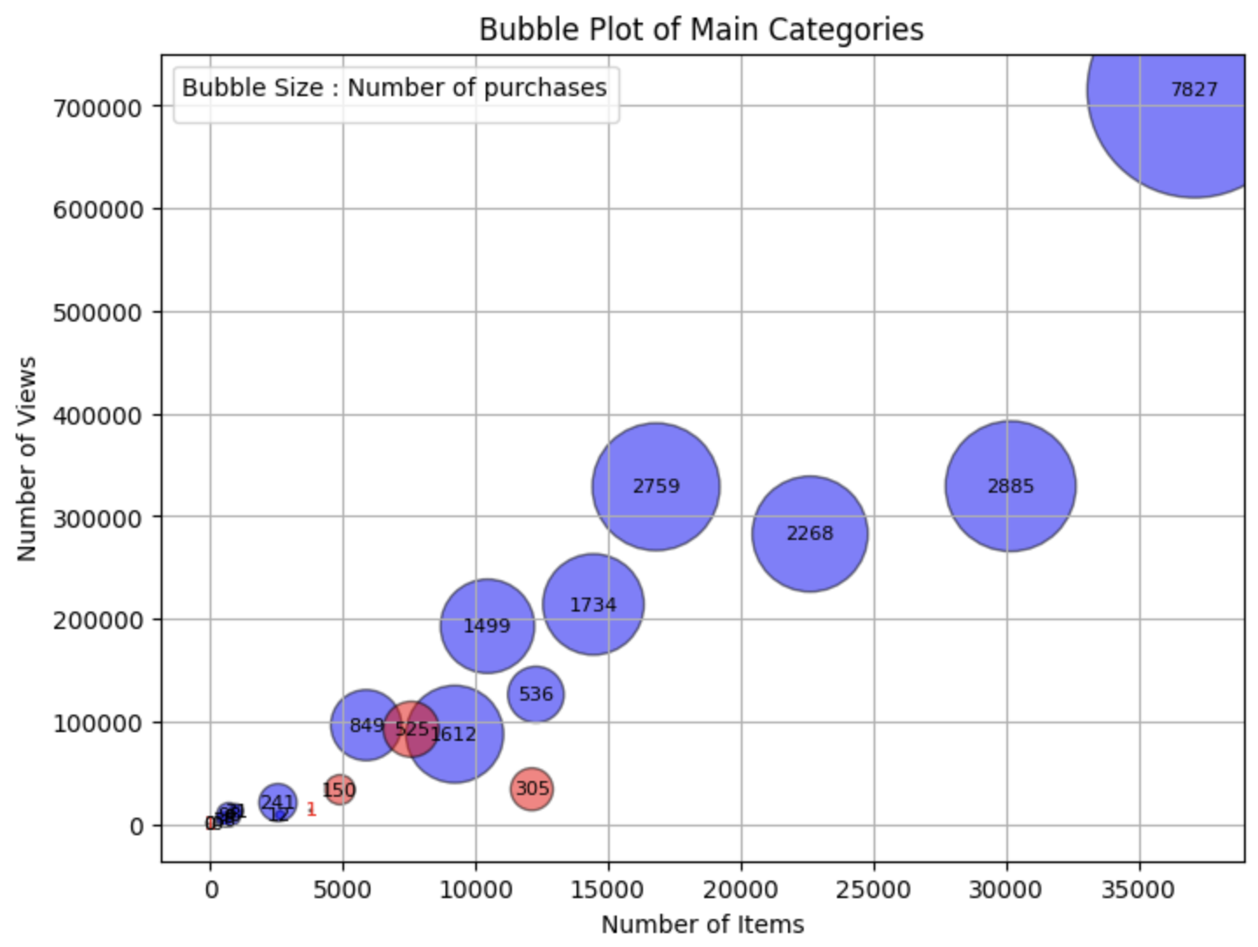
Even the top selling items don’t have average ratio
Average view vs purchase ratio
Top Items
Generating Interest But not buying intent!
Only 435 items among 400K are responsible for 20% of total sales!
Reasons might include unclear product descriptions, poor quality image.
95% of items were not available the whole time period.
Mostly all items has above average conversion rate
*Availability data was recorded on a weekly level, so this is an approximation

Slide 20
Even the top selling items don’t have average ratio
Average view vs purchase ratio
Top Items
Generating Interest But not buying intent!
Only 435 items among 400K are responsible for 20% of total sales!
Reasons might include unclear product descriptions, poor quality image.
95% of items were not available the whole time period.
Mostly all items has above average conversion rate
*Availability data was recorded on a weekly level, so this is an approximation

Slide 21
Even the top selling items don’t have average ratio
Average view vs purchase ratio
Top Items
Generating Interest But not buying intent!
Only 435 items among 400K are responsible for 20% of total sales!
Reasons might include unclear product descriptions, poor quality image.
95% of items were not available the whole time period.
Mostly all items has above average conversion rate
*Availability data was recorded on a weekly level, so this is an approximation

Slide 22
Even the top selling items don’t have average ratio
Average view vs purchase ratio
Top Items
Generating Interest But not buying intent!
Only 435 items among 400K are responsible for 20% of total sales!
Reasons might include unclear product descriptions, poor quality image.
95% of items were not available the whole time period.
Mostly all items has above average conversion rate
*Availability data was recorded on a weekly level, so this is an approximation

Slide 23
Data Insights
How does the seasonal trend look? Can we explain those? Can we focus our marketing or promotional strategy to fit them?
Trend
What are the dropout rates between each step to understand potential friction points in the buying process?
Bottlenecks
Which are the loyal customers? How often do they purchase in a specified timeframe? Which segment can be potential churners?
Customer Segmentation
Venus
Which are the top selling items? What categories do they belong to? Which products are viewed but not purchased?
Item Segregation
Abnormality
Are there any unusual traffic? How do we detect them? Can they affect the recommendations?

Slide 24
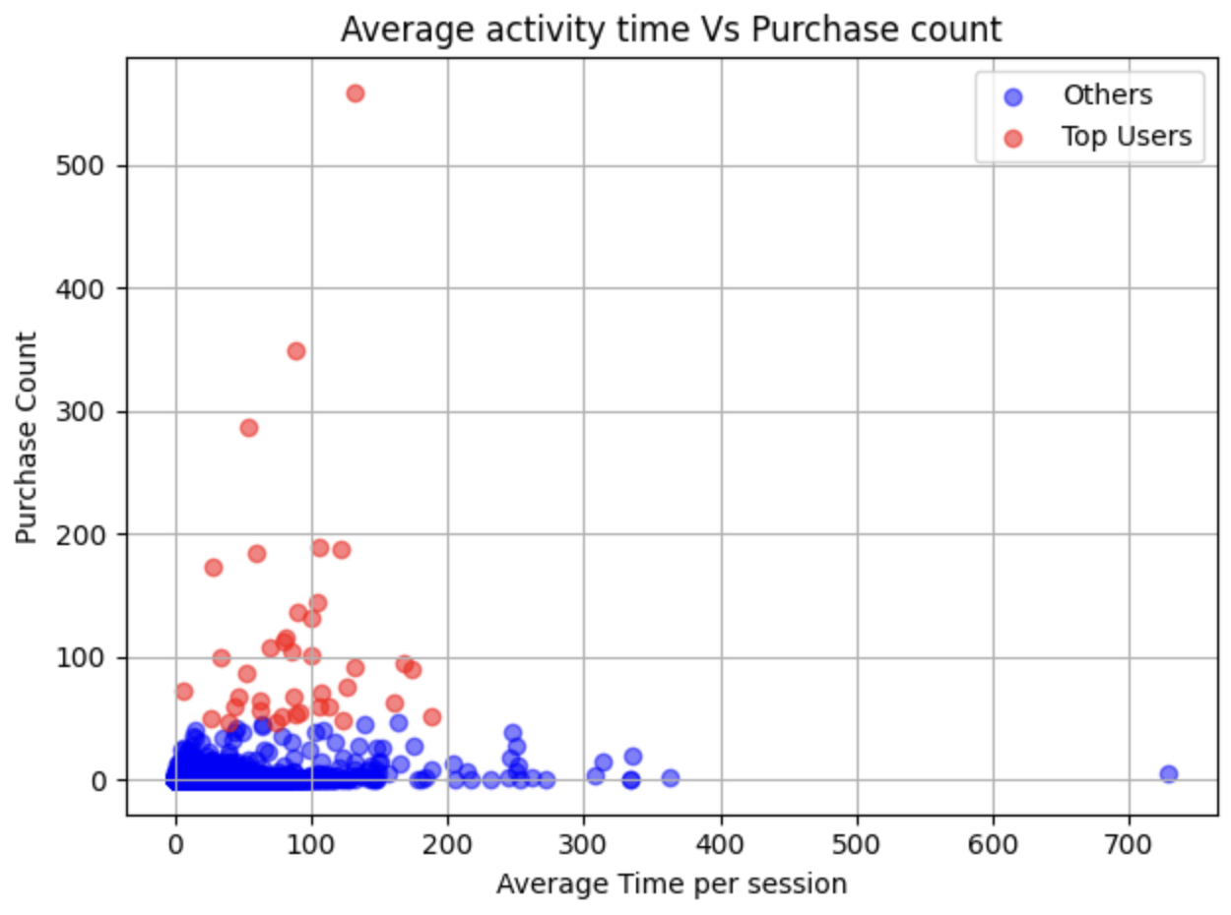
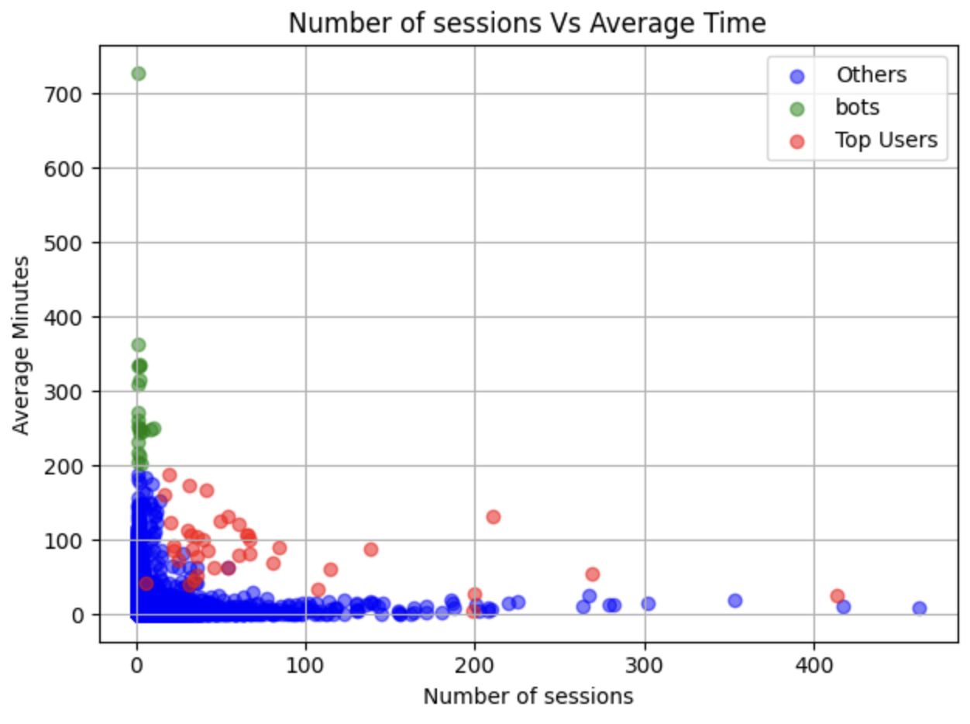
We only have view(clicks) timestamp, not visit timestamp. So, average activity time is higher in reality!
Potential Automatic Bots!
We should drop these users, as they are creating abnormal traffic which might affect the recommendation process!

Slide 25
Modeling
As the original data was huge, we take a subset of the data.
We sample 10000 items from all the items that were mostly available.
We do a time splitting for train and validation data. The last 30 days data were kept as validation.

Slide 26
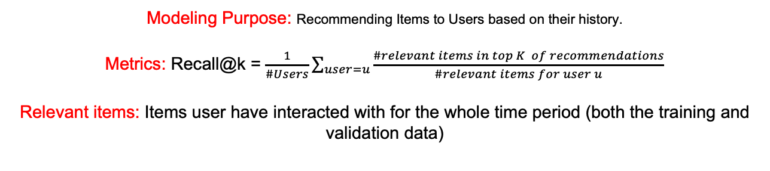
Modeling
As the original data was huge, we take a subset of the data.
We sample 10000 items from all the items that were mostly available.
We do a time splitting for train and validation data. The last 30 days data were kept as validation.
Modeling Purpose: Recommending Items to Users based on their history.
Metrics: Recall@k = $\frac{1}{\#Users}\sum_{user=u}{\frac{\#relevant items in top K of recommendations}{\#relevant items for user u}}$
Relevant items: Items user have interacted with for the whole time period (both the training and validation data)

Slide 27

Modeling
As the original data was huge, we take a subset of the data.
We sample 10000 items from all the items that were mostly available.
We do a time splitting for train and validation data. The last 30 days data were kept as validation.
Modeling Purpose: Recommending Items to Users based on their history.
Metrics: Recall@k = $\frac{1}{\#Users}\sum_{user=u}{\frac{\#relevant items in top K of recommendations}{\#relevant items for user u}}$
Relevant items: Items user have interacted with for the whole time period (both the training and validation data)
Strategy: Recommend the items that the user has recently interacted with.
(Recently viewed items on Amazon)
 | K=1 | K=10 | K=50
Recall@k | 0.52 | 0.67 | 0.69
These are some very high values. Because in ecommerce, people take time before purchasing something, and they repeatedly interact with them before buying! But we don’t need a recommender system for that!

Slide 28
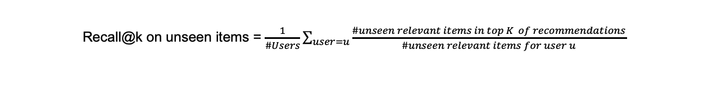
Modeling
We want to see how the recommender system performs in terms of recommending new items. Because in e-commerce that’s the goal!
Recall@k on unseen items = $\frac{1}{\#Users}\sum_{user=u}{\frac{\#unseen relevant items in top K of recommendations}{\#unseen relevant items for user u}}$
Notes:
Out of all new items user has interacted with in the test set, how many of them the rec system can predict.
Item item similarity works best for most cases, which also make sense because we tend to buy similar things.

Slide 29
Modeling
We want to see how the recommender system performs in terms of recommending new items. Because in e-commerce that’s the goal!
Recall@k on unseen items = $\frac{1}{\#Users}\sum_{user=u}{\frac{\#unseen relevant items in top K of recommendations}{\#unseen relevant items for user u}}$
User-user CF: Recommends items those are viewed by similar users.
Item Item CF: Recommends similar items that user has interacted with.
SVD: Popular matrix factorization technique that estimate the interaction between user and item
Interaction Matrix Type | Collaborative Filtering | Recall@k – all relevant items |  |  | Recall@k – unseen relevant items
How we quantify the interactions to calculate similarity? |  | K=1 | K=10 | K=50 | K=1 | K=10 | K=50
Count of interaction between user and item | User - user | 0.5 | 0.66 | 0.69 | 0 | 0.006 | 0.006
 | Item - item | 0.51 | 0.68 | 0.7 | 0.006 | 0.042 | 0.048
 | SVD | 0.07 | 0.14 | 0.23 | 0.007 | 0.017 | 0.037
Weighing type of interaction between user and item ( purchase:3, add to cart: 2, view:1) | User - user | 0.51 | 0.67 | 0.69 | 0.005 | 0.01 | 0.012
 | Item - item | 0.52 | 0.68 | 0.7 | 0.008 | 0.034 | 0.038
 | SVD | 0.08 | 0.17 | 0.29 | 0.006 | 0.014 | 0.031
Notes:
Out of all new items user has interacted with in the test set, how many of them the rec system can predict.
Item item similarity works best for most cases, which also make sense because we tend to buy similar things.

Slide 30

Any questions?

